Slide 1


📱 Telecom AI Agent POC
Architecture, AI Workflow, and System Design

Slide 2
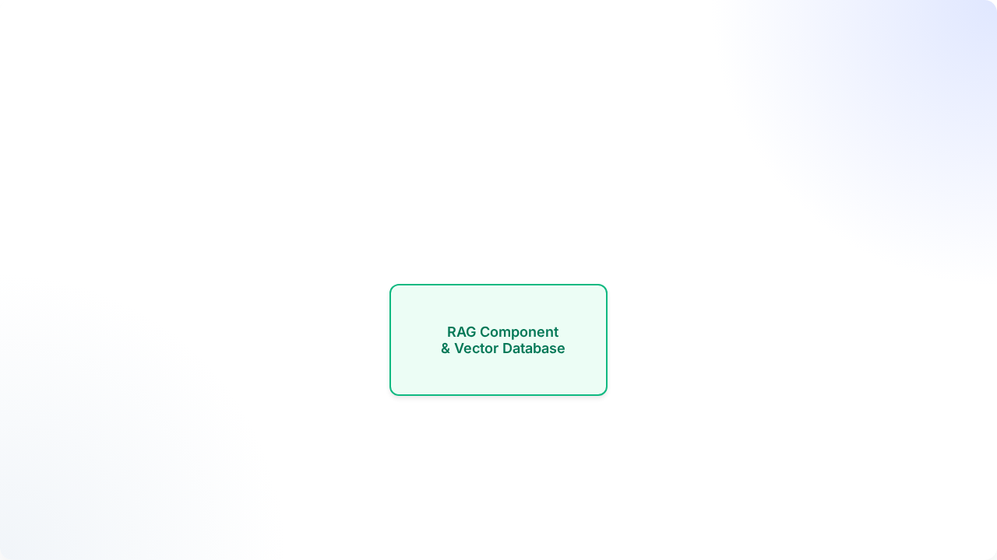





1. High-Level System Architecture

Slide 3

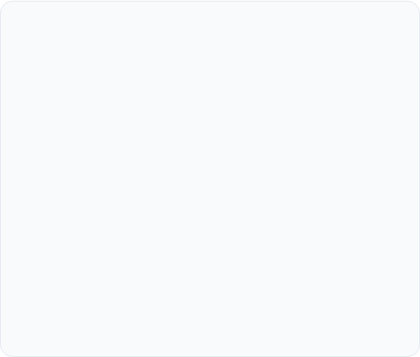
2. Models & Hardware Selection
I use Ollama to run models locally within the Docker network, ensuring data privacy and operational control.
LLM: qwen2.5:7b
Embeddings: nomic-embed-text
Highly capable open-weights model in the 7B parameter class.
Produces highly contextual 768-dimensional vectors.
Exceptional at strict tool calling (function calling) and following complex system prompts.
Extremely fast for both ingestion and retrieval.
Efficient enough to run on local hardware (GPUs or modern CPUs).
Perfectly optimized for a rapid RAG (Retrieval-Augmented Generation) architecture.

Slide 4


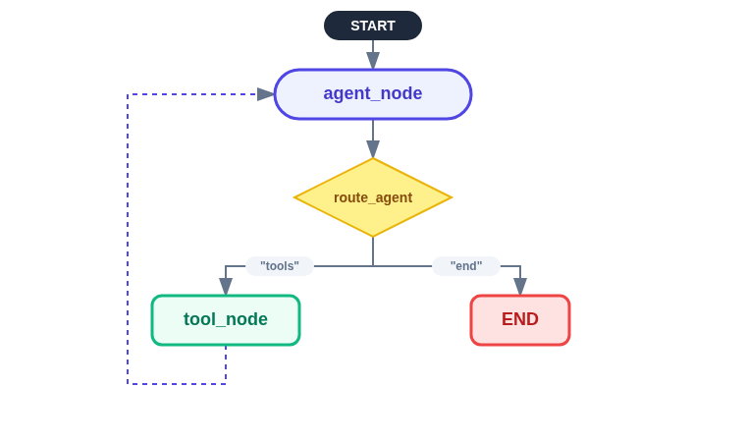
3. LangGraph Orchestration Workflow
AgentState (TypedDict)
messages: List[AnyMessage]
customer_id: int
step_count: int
pending_action: dict | None

Slide 5









4. Retrieval-Augmented Generation
Our Knowledge Base relies on PostgreSQL with the powerful pgvector extension.
Chunking Strategy
Retrieval Engine
Strict Filtering
I use RecursiveCharacterTextSplitter with chunk_size=1000 and chunk_overlap=200. This ensures vital context across pages is never lost.
PDFs and text snippets are vectorized into 768-D arrays. I utilize Cosine Distance (similarity_search_with_score) for lightning-fast matching.
We strictly filter out chunks with a cosine distance > 0.5. This guarantees the model doesn't hallucinate based on loosely related text.

Slide 6


5. Tools & System Instructions
Explicit Agent Tools
Instruction Rules
The Agent is restricted to 5 tools to prevent hallucination:
System Prompts strictly guide behavior:
Rule 1: Never make up policies. Only cite sources returned by the retrieve_context tool.
get_customer_package: Retrieves active plan.
get_data_balance: Retrieves exact GB balance.
Rule 2: Do not execute destructive actions without explicit user confirmation.
change_customer_package: Initiates plan migration.
Rule 3: Always prompt the user for missing tool parameters before executing a call.
create_support_ticket: Files formal tickets.
retrieve_context: Queries the RAG Vector DB.

Slide 7









6. Observability & Logging
I implemented a custom, state-of-the-art telemetry system to monitor LLM behavior.
Context Tracking
Trace Assembly
Database Persistence
Uses Python's ContextVar to track unique request_ids asynchronously across complex LangGraph node traversals.
Captures ENTER, TOOL_CALL, RAG_QUERY, and LLM_RESPONSE events in real-time in memory.
On REQUEST_END, the assembled JSON trace is permanently written to PostgreSQL for Admins to view in a color-coded UI.

Slide 8

7. Relational Database Schema
Alongside vector storage, Postgres handles all structured business logic securely.
Table Name | Purpose / Description
users | Manages authentication, passwords, and Role-Based Access (Admin vs Customer).
customer_data | The mock CRM containing real-time data balances and active customer packages.
chat_history | Persistent, chronologically ordered chat logs for UI rendering and contextual memory.
support_tickets | Tracks customer complaints, detailed descriptions, and resolution statuses.
orchestration_logs | Stores persistent JSONB telemetry traces for the Observability dashboard.

Slide 9
8. Edge Cases & Handling
Infinite Loop Cap: If the LLM gets stuck calling tools, a hardcap of step_count = 6 forcefully routes to END and suggests filing a ticket.
Stateless Confirmation: The pending_action dict is securely passed to the React UI, preventing state loss across HTTP requests during plan changes.
Safe Vector Resets: "Clear KB" utilizes delete_collection instead of dropping schemas, preserving integrity.

Slide 10






9. Error Handling
Robust fault tolerance is built into the architecture at every layer.
Database Resilience
RAG Failsafes
Tool Validation
Uses SQLAlchemy async sessions injected via FastAPI Depends, ensuring DB connections are cleanly rolled back and closed on failure.
Built-in failsafes gracefully return "No knowledge base found" to the LLM instead of crashing the backend if the PGVector schema is empty.
If a tool fails (e.g., bad parameter), the exact error string is injected back into the LangGraph state so the LLM can self-correct and try again.

